Slide 1
Recognition of Named Entities in Mahabharat
Named Entity Recognition
Project Guide: Dr Ranjani Parthasarathi, Professor, Department of Information Science and Technology
Aishwarya K - 2018115008
Nithyasri L - 2018115063
Shanmuga Priya M- 2018115103

Slide 2
Problem Statement
“Identification of named entities, including but not restricted to places and characters in the English translation of Mahabharata using Deep Learning Techniques”

Slide 3
Literature Survey
Title | Author,journal/conference name and year | Problem Statement | Methodology | Pros and advantage
BERT: Pre-training of Deep Bidirectional Transformers for Language Understanding | Jacob Devlin Ming-Wei Chang Kenton Lee Kristina Toutanova,2019 | BERT is designed to pretrain deep bidirectional representations from unlabeled text by jointly conditioning on both left and right context in all layers. | During pre-training, the model is trained on unlabeled data over different pre-training tasks. For fine tuning, the BERT model is first initialized with the pre-trained parameters, and all of the parameters are fine-tuned using labeled data from the downstream tasks. | The pre-trained BERT model can be fine tuned with just one additional output layer to create state-of-the-art models for a wide range of tasks, such as question answering and language inference.

Slide 4
Objectives of the Project
NER deals with extracting the real-world entity from the text such as a person, an organization, or an event.
Named Entity Recognition is also simply known as entity identification, entity chunking, and entity extraction. They are quite similar to POS(part-of-speech) tags.

Slide 5
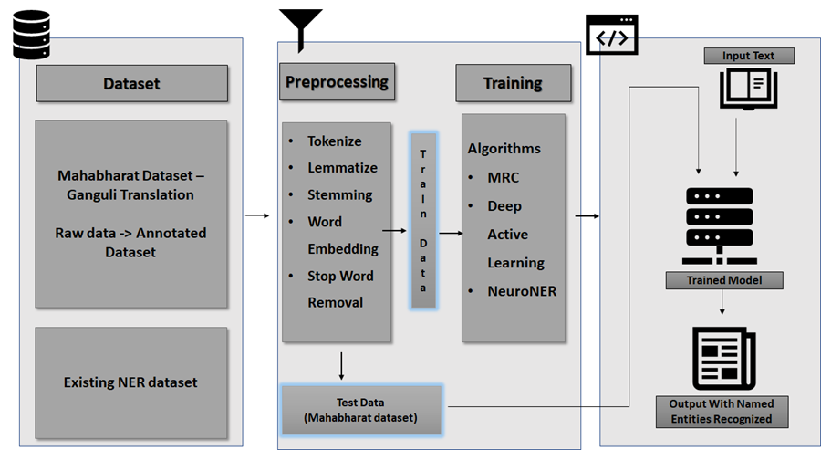

Slide 6
Module Descriptions
Data Preprocessing
Extract the sentences from .txt files
Separate sentences and tags
Word embedding using bert-base-cased
Convert tags to indicess
Data Preprocessing
Download pre trained model
Fine Tune the parameters for NER detention
Train the model
Data Preprocessing
Extract sentences from the text in Mahabarat files
Perform POS tagging
Perform Chunking

Slide 7
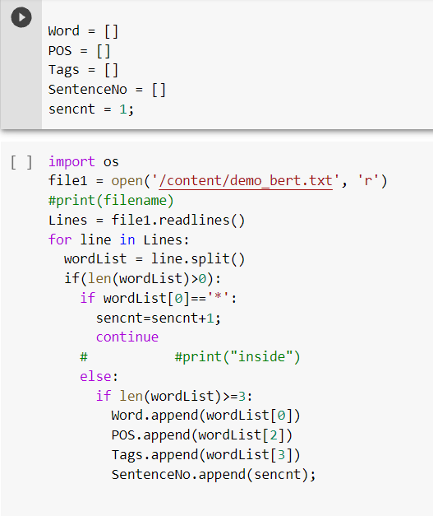
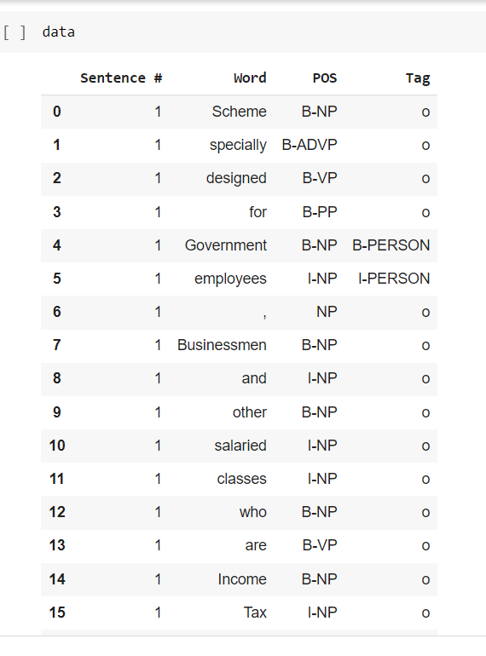
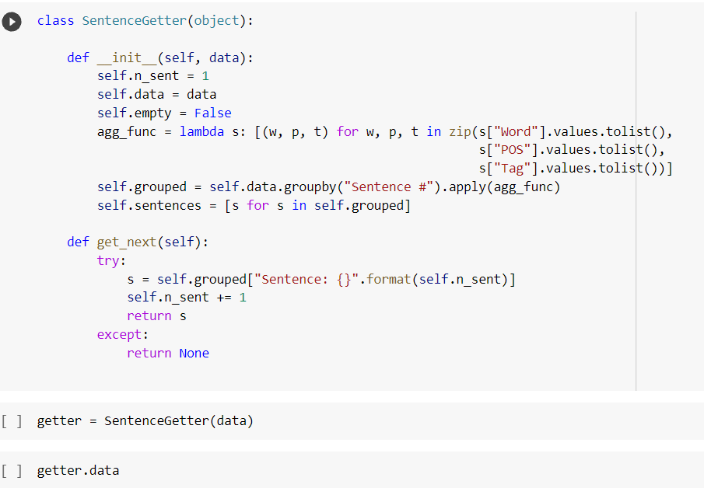
Module Description
Data Preprocessing

Slide 8
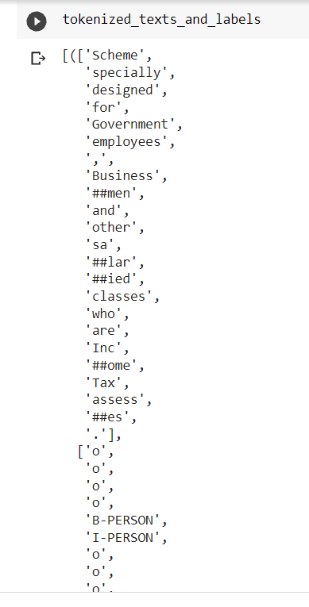
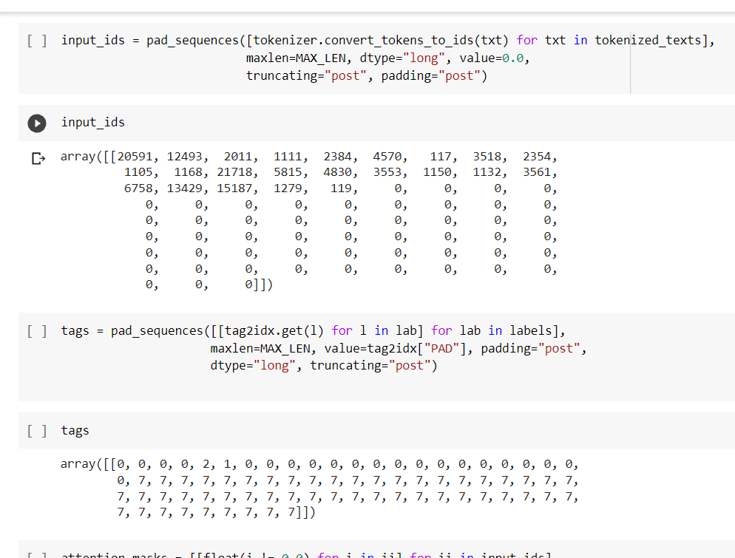
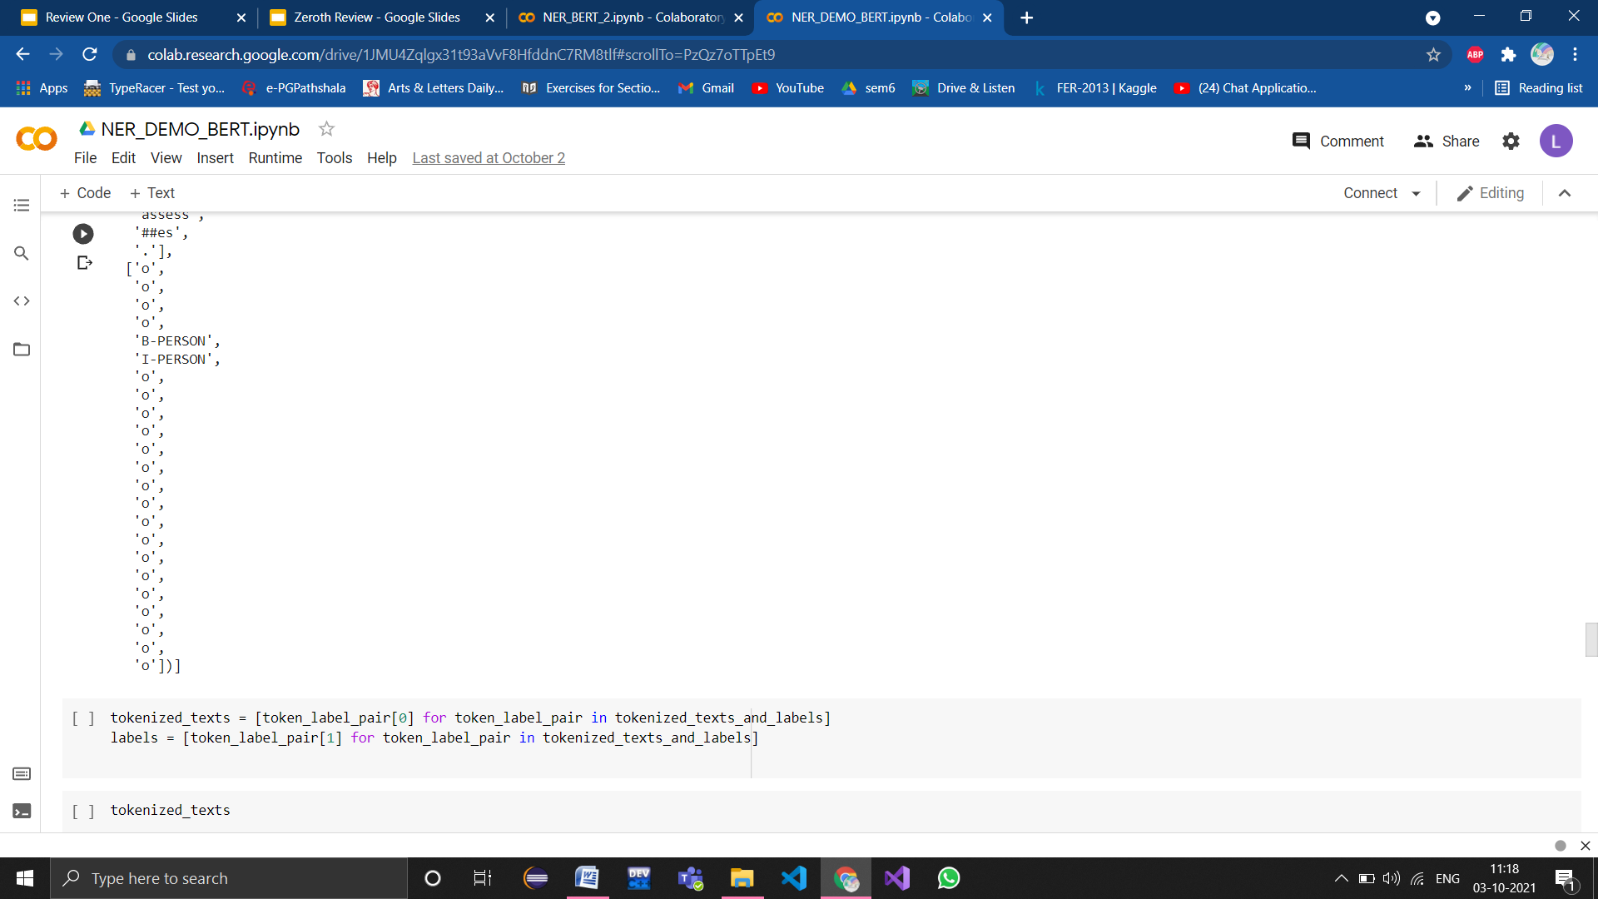
Module Description
Data Preprocessing

Slide 9
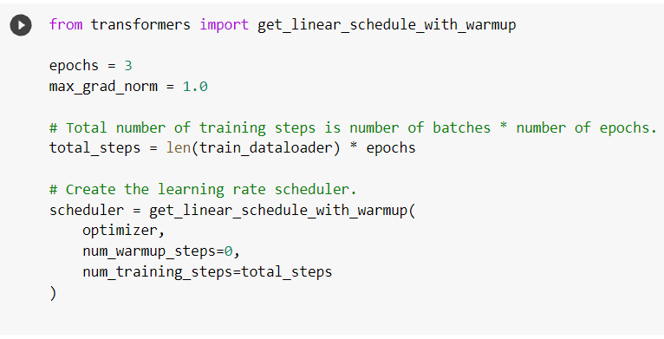
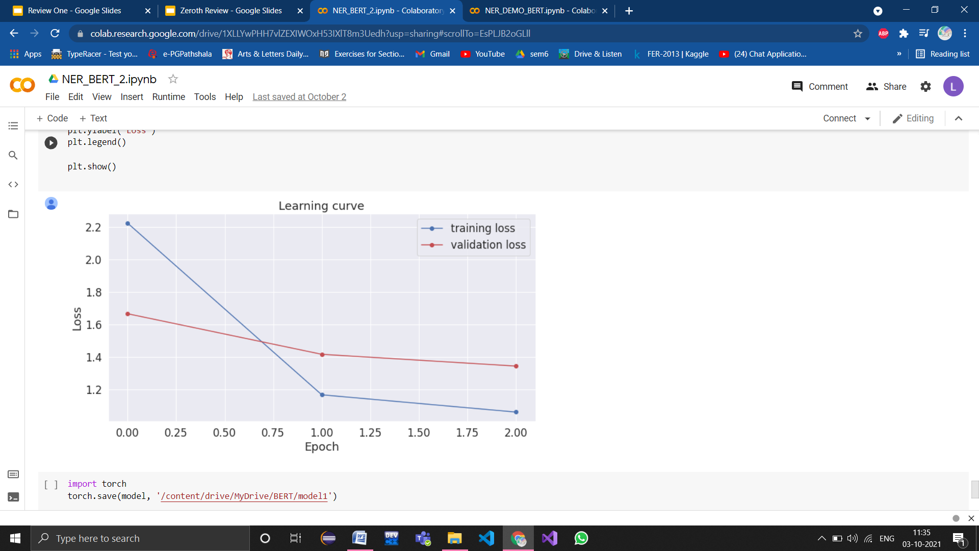
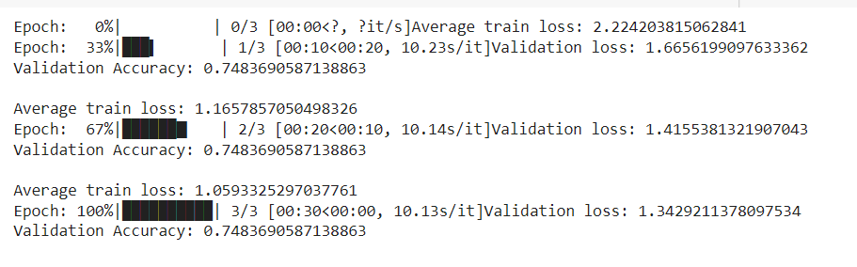
Module Description
Model

Slide 10
Module Description
Data Preprocessing on Mahabarat text
"I am Arjuna!"
CHUNKING
POS
['"', '<O>',
I', '<S-NP>',
'am', '<S-VP>',
'Arjuna', '<S-NP>', '!', '<O>',
'"', '<O>']
['"','<``>',
'I','<PRP>',
'am','<VBP>',
'Arjuna', '<NNP>',
'!', '<.>',
'"', "<''>"]
<S-NP> noun phrase
<S-VP> verb phrase
<O> Other
<PRP> Personal pronoun
<VBP> Verb, non-3rd person singular present
<NNP> Proper noun, singular

Slide 11
Evaluation Metrics /parameter used for the project
We extract the predict tags and valid tags for the given data to calculate the accuracy using the accuracy score function.
The validation accuracy of the fine tuned BERT model that predicts the tag category of every entity in the sentence is 95%.

Slide 12
Work Split up
Aishwarya
Researched and obtained dataset from FIRE conference
Built a Bert model
Fine tuned parameters of Bert Model
Determined the accuracy
Plotted the validation loss
Nithyasri
Data Preprocessing on Mahabharat Data
Extracted the sentences from the Ganguli Translations
Used Flair POS and Chunking methods for tagging the words
Saved the annotated data in a csv file
Shanmuga Priya
Study of Bert Model
Data Preprocessing for Bert Model
Took tagged sentences from a tagged dataset
Performed embedding using Bert Vocab

Slide 13
References:
J. Li, A. Sun, J. Han and C. Li, "A Survey on Deep Learning for Named Entity Recognition," in IEEE Transactions on Knowledge and Data Engineering, doi: 10.1109/TKDE.2020.2981314.
S. K., A. Ravikurnar, V. R C., A. Reddy D., A. K. M. and S. K.P., "Sentiment Analysis of Indian Languages using Convolutional Neural Networks," 2018 International Conference on Computer Communication and Informatics (ICCCI), 2018, pp. 1-4, doi: 10.1109/ICCCI.2018.8441371.
Fritzler, A., Logacheva, V., & Kretov, M. (2019). Few-Shot Classification in Named Entity Recognition Task. In Proceedings of the 34th ACM/SIGAPP Symposium on Applied Computing (pp. 993–1000). Association for Computing Machinery.
First Review

Slide 14
References
Olsson, Fredrik. (2009). A literature survey of active machine learning in the context of natural language processing.
J. Li, A. Sun, J. Han and C. Li, "A Survey on Deep Learning for Named Entity Recognition," in IEEE Transactions on Knowledge and Data Engineering, doi: 10.1109/TKDE.2020.2981314.
Meizhi Ju, Makoto Miwa, and Sophia Ananiadou. 2018. A neural layered model for nested named entity recognition. In Proceedings of the 2018 Conference of the North American Chapter of the Association for Computational Linguistics: Human Language Technologies, Volume 1 (Long Papers)
First Review

Slide 15
References
Yu, Juntao & Bohnet, Bernd & Poesio, Massimo. (2020). Named Entity Recognition as Dependency Parsing. 6470-6476. 10.18653/v1/2020.acl-main.577.
Florian, Radu & Ittycheriah, Abe & Jing, Hongyan & Zhang, Tong. (2004). Named Entity Recognition through Classifier Combination. Proceedings of CoNLL-2003. 10.3115/1119176.1119201.
D. Kim et al., "A Neural Named Entity Recognition and Multi-Type Normalization Tool for Biomedical Text Mining," in IEEE Access, vol. 7, pp. 73729-73740, 2019, doi: 10.1109/ACCESS.2019.2920708.
First Review

Slide 16
Reference
Shen, Yanyao & Yun, Hyokun & Lipton, Zachary & Kronrod, Yakov & Anandkumar, Animashree. (2017). Deep Active Learning for Named Entity Recognition.
Feng, Jingrong & Meng, Yuxian & Han, Qinghong & Wu, Fei & Li, Jiwei. (2020). A Unified MRC Framework for Named Entity Recognition. 5849-5859. 10.18653/v1/2020.acl-main.519.
K. Byrne, "Nested Named Entity Recognition in Historical Archive Text," International Conference on Semantic Computing (ICSC 2007), 2007, pp. 589-596, doi: 10.1109/ICSC.2007.107.
First Review
‹#›

